Slide 1
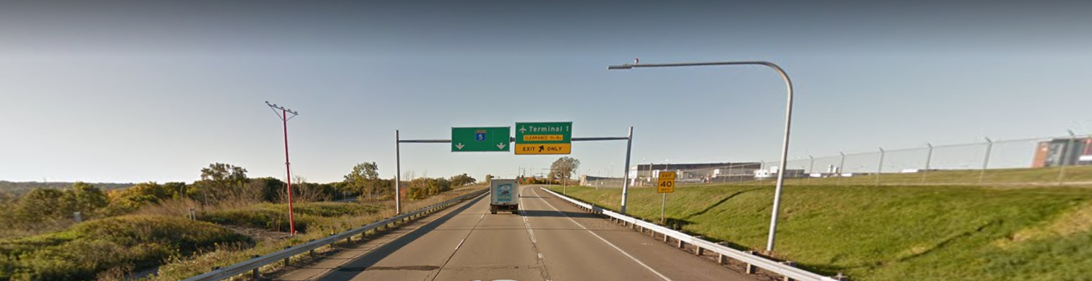
Highway 5 at MSP Airport
Richfield City Council
January 28, 2020

Slide 2
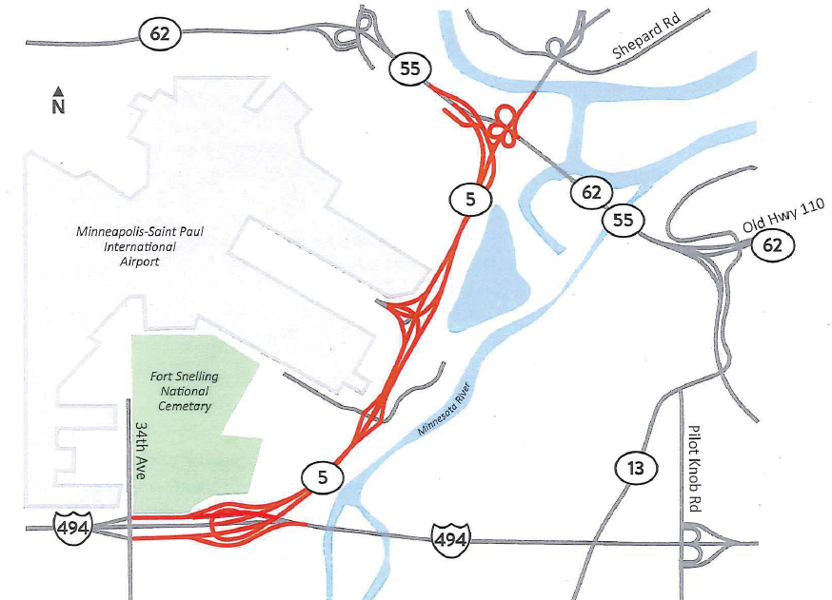
Project Scope
Concrete overlay or reconstruction
Bridge Repair/Redeck
Concrete pavement repair
Concrete overlay or reconstruction
Will last 25 + years until next fix (minor CPR)
Bridge re-deck
Will last 15 + years until next fix (bituminous overlay)
Bridge repair
Concrete pavement repair
Notes:
Airport to East
Original underlying concrete constructed in 1960
Jointed Reinforced Concrete
First asphalt Overlay in 1974
Resurfacing Projects in 1981, 1989, 1998, 2010
Pavement is old & tired, needs a long-term fix
Airport to West
Original concrete constructed in 1986
Jointed Reinforced Concrete
Minor Concrete Rehab in 2012
Another Concrete Rehab is needed

Slide 3
Project Schedule
Project to be completed in one construction season
2020
April
May
June
July
August
September
October
Stage 1
Stage 2
Stage 3

Slide 4
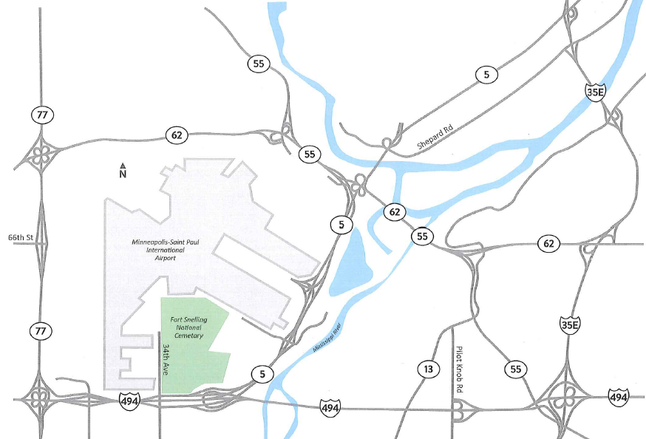
Project staging and detours
Stage 1
April to July 2020
EB Highway 5 Closed
Stage 1 and 2 are the stages we are most interested in and concerned about people getting to the airport
2020
A
M
J
J
A
S
O
1
2
3
Notes:
Highway 5 closed 494 over Mississippi River

Slide 5
Project staging and detours
Stage 1
April to July 2020
EB Highway 5 Closed
Detour routes

Slide 6
Project staging and detours
Stage 2
July to August 2020
EB Highway 5 Closed
Partial closure of Hwy 5 and Hwy 62 interchange
2020
A
M
J
J
A
S
O
1
2
3
Notes:
The closure of EB 5 scaled back to highway 62
One lane in each direction over river as traffic is moved to EB side
WB side of interchange closed
Hoping to have EB 5 open by stage 2, but unsure at this time

Slide 7
Project staging and detours
Stage 3
August to October 2020
WB Highway 5 Closed
2020
A
M
J
J
A
S
O
1
2
3

Slide 8
Project staging and detours
Stage 3
August to October 2020
EB Highway 5 Closed
Detour routes

Slide 9
How will traffic be impacted?
How will traffic patterns change and what will be the impact?
Origin and destination data
Existing traffic data
Traffic modeling
These tools help us understand traffic issues and identify “problem spots”
Identify mitigation strategies to implement
Communicate impacts to the public
Identify areas to watch and have contingencies

Slide 10
Communications
Real time travel info
Know before you go
Informed travel decision
Strategic Communications Group
Communication Consultant
MnDOT
Partners

Slide 11
Know before you go
GOALS
Reach as many people as possible within a six-hour radius of the MSP Airport.
Communicate early and often so people are aware of construction well before they travel.
Keep people informed of detours and delays so they can understand the impacts to their trip and plan accordingly.
Create easy-to-use tools to help people prepare for what they may encounter while on the road.

Slide 12
Know before you go
IMPLEMENTATION
Promotional website
Email updates
Airline information
Partner communications
Business communications
Paid advertising
Media coverage
Social media
Highway signage
Neighborhood outreach/ presentations

Slide 13
Key audiences
KEY AUDIENCES
Local governments
Air travelers
Airport employees and functions (including EMS)
Visitors
(travel agencies, hotels, chambers of commerce, convention & visitors bureaus)
Large employers
Area businesses
Commuters
Transit riders
Nearby neighborhoods
Destinations

Slide 14
Promotional website
Interactive
Travel information and tools
  Current and upcoming traffic impacts
Planning information and tools for
  Air travelers
  Visitors
  Commuters
  Nearby neighborhoods
  Area businesses
Connections
  Project email updates
  Shareables (e.g. social media)
Partnerships and resources
WHAT’S DIFFERENT?
Memorable URL
Easy navigation

Slide 15
Key dates (tentative)
Jan - Apr
Information coordination/preparedness
Mid/late Feb
Website (soft launch)
Mid March
MnDOT construction kickoff
April
CONSTRUCTION BEGINS
Mid April
Traffic impacts begin

